Slide 1


Public Policy Advisory Committee
(PPAC)

Slide 2
California's Public Policy Processes
Legislative and Budget Processes
Two-year legislative cycle, but active months are January to September
  Governmental Affairs staff will bring forth bills with corresponding positions at a future meeting
Budget process – January to May, with final budget approved in June
First 5 CA engagement and involvement
  Governmental Affairs staff meets with Governor’s Office, Department of Finance, legislative members and staff to learn and discuss budget, policy, and regulator proposals
    Provide relevant information at Public Policy Advisory Committee meetings
  After Public Policy Advisory Committee has reviewed and provided guidance on public policy proposals, Governmental Affairs staff will submit position letters, attend hearings, testify, and participate in coalition efforts.
Regulatory Process
Year-round process
First 5 engagement and involvement
  Governmental Affairs staff will attend and participate in state agency stakeholder and implementation working groups, as well as provide written response to regulatory changes to the appropriate agencies.

Slide 3
First 5 California Policy Positions
Bill Position | Description
Sponsor | Develop legislative, budget, and/or regulatory proposal, background information, and secure author; actively advocate for the passage of the proposal as a top priority as it aligns with First 5’s Young Children Policy Agendas, Mission Statement, North Star, and Audacious Goal. Actively advocate for the passage of the proposal.
Co-Sponsor | Work cooperatively with one or more organizations to develop legislative, budget, and/or regulatory proposal, background information, and secure author as the proposal aligns with First 5 California’s Young Children Policy Agendas, Mission Statement, North Star, and Audacious Goal. Actively advocate for the passage of the proposal.
Support | Actively pursue and advocate for passage of a policy proposal as it aligns with First 5 California’s Young Children Policy Agendas, Mission Statement, North Star, and Audacious Goal. Actively advocate for the passage of the proposal.

Slide 4
First 5 California Policy Positions
Bill Position | Description
Support if Amended | Support only if appropriate amendments are adopted in a legislative, budget, and/or regulatory proposal, to ensure alignment of First 5 California’s Young Children Policy Agendas, Mission Statement, North Star, and Audacious Goal.
Oppose | Actively pursue and advocate for the defeat of a legislative, budget, and/or regulatory proposal as it does not align with First 5 California’s Young Children Policy Agendas, Mission Statement, North Star, and Audacious Goal.
Oppose Unless Amended | Actively pursue and advocate for defeat of a legislative, budget, and/or regulatory proposal if it is not amended to address concerns as it does not align with First 5 California’s Young Children Policy Agendas, Mission Statement, North Star, and Audacious Goal.

Slide 5
First 5 California Policy Positions
Bill Position | Description
Monitor | Track a legislative, budget, and/or regulatory proposal and any amendments to determine impact as the bill progresses through the legislative process. Should major changes occur that requires a formal position, bill will be reviewed by the Public Policy Advisory Committee and Executive Director.
Neutral/No Position | Staff notes the existence of a legislative, budget, and/or regulatory proposal, but First 5 California does not have a policy position on the topic, and no action is taken unless amendments change the status of the bill.

Slide 6
Levels of Priority Proposals
Bill Position | Description
Level 1 | Sponsor Public Policy Proposal: Align with First 5 California’s Young Children Policy Agendas, Mission Statement, North Star, and Audacious Goal. Draft language/amendments; organize partners/meetings; provide testimony/presentations; participate in outreach for support; submit letters/statements of support
Level 2 | Priority Public Policy Proposal: Align with First 5 California’s Young Children Policy Agendas, Mission Statement, North Star, and Audacious Goal. Provide support; submit letters/statements of support
Level 3 | Public Policy Proposal expressly consistent with First 5 California’s Young Children Policy Agendas, Mission Statement, North Star, and Audacious Goal: Submit letters/statements of support

Slide 7
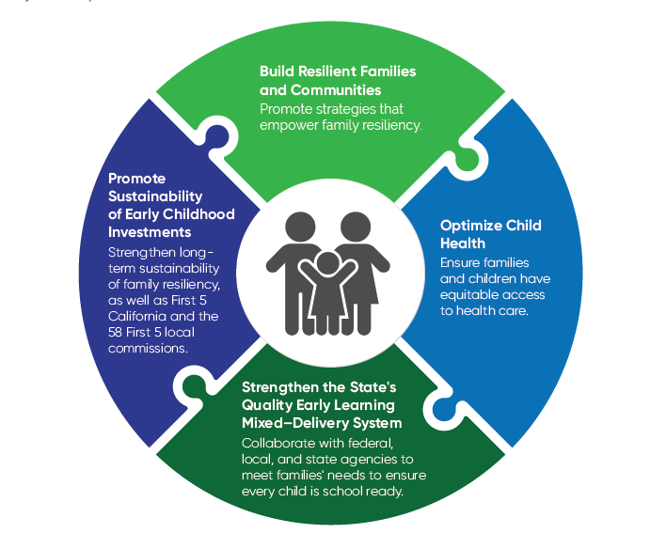
Policy Priorities

Slide 8
F5CA’s Governmental Affairs Coalitions
First 5 California is a member of the following coalitions, which take positions on budget items and legislation, as well as coordinate work with various organizations.
Early Care and Education (ECE) Coalition
California Earned Income Tax Credit (CalEITC) Coalition
California Work and Family (CA WFC) Coalition
  Related to contract work with Legal Aid at Work regarding Paid Family Leave policies
Stronger CA Coalition

Slide 9

Questions?

Slide 10

Thank you!

